Slide 1


Grassland
Introduction

Slide 2
Learning Outcomes
You should be able to:
Define DM and DMD
List and describe the factors that contribute to the value of grassland
Identify the three categories of grasslands and discuss their value
Discuss the growth cycle of grass and how the digestibility of grass changes throughout the growing season
Give characteristics of popular species of grass and clover
Discuss seed mixtures commonly used in agriculture
Discuss how food production is influenced by grassland production

Slide 3
Key Terms
Dry Matter (DM) – the matter remaining in a food sample after the water has been removed
Dry Matter Digestibility (DMD) – the amount (%) of dry matter that can be digested by an animal
Heading out – The emergence of the inflorescence of the grass.

Slide 4
Grassland Value
When determining the value of an area of grassland there are three factors to consider.
Botanical Composition – Different types of vegetation
Production Levels – How much grass is produced on the land
Stocking Rate – Number of animals on a set area of land
The botanical composition affects the amount of grass produced and in turn the production levels affects how many animals can be put on the land.

Slide 5
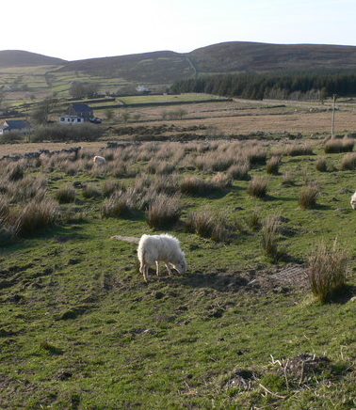
Grassland Categories – Rough mountain or hill grazing

Slide 6
Grassland Categories – Rough mountain or hill grazing
Land is often peaty & acidic
Difficult to cultivate
Botanical Composition – Varies greatly, poor grasses, heather & gorse
Production Levels – Poor grasses => Low LWG
Stocking Rate – Low nutrition => Low stocking rate

Slide 7
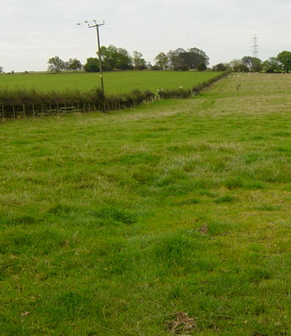
Grassland Categories – Permanent Grassland

Slide 8
Grassland Categories – Permanent Grassland
Land is never ploughed or reseeded
Can be fertilised => Improves quality & productivity
Botanical Composition – Variable, poor and productive grasses found
Production Levels – Can be improved with fertilisation & liming => Higher production
Stocking Rate – Improved grazing => Improved Stocking rates

Slide 9
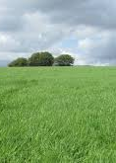
Grassland Categories - Leys

Slide 10
Grassland Categories - Leys
Field or Pasture sown by farmer
Temporary in nature, reseeded regularly
Botanical Composition – 1 or 2 productive grasses and clover dominate
Production Levels – Productive grasses used => High LWG
Stocking Rate – High levels of nutrition => High stocking rates

Slide 11
Characteristics of grass
When assessing a species of grass there are three factors we consider to determine the quality of the grass and its use in agriculture.
Palatability – How nice it tastes to the animal
Productivity – How much it grows
Digestibility – How much is used by the animal in comparison to how much is eaten

Slide 12
The growth cycle of grass
Vegetative
  Tillers produced, leafy grass with lots of sugar and protein
Elongation
  Stem develops and grows longer
Reproduction
  Seed head emerges (heading out) and stem hardens to support the extra length, produces more fibre

Slide 13
Digestibility
What is the most digestible constituent?
What two products do you want the most of?

Slide 14
Digestibility
What constituents are decreasing as the growing season goes on?
What constituents are increasing as the growing season goes on?
Why do you think this happens?

Slide 15
Digestibility through the growing season
When in its vegetative state grass produces sugar and protein meaning it is highly digestible.
Once grass flowers, the stem needs to support the head.
This means stronger materials are needed and so fibre is produced at the expense of sugar and protein, reducing the digestibility.

Slide 16
Tillering
Tillering is the growth of side shoots from the main stem of a plant.
Benefits:
  Close sward (reduces weeds)
  Higher production
  Prevents poaching
How to encourage:
  Certain species
  Topping
  Grazing (sheep or light stock best)

Slide 17
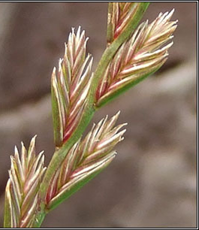
Perennial Ryegrass

Slide 18
Perennial Ryegrass
Well drained soils with a pH of 6 or greater
High productivity, palatability and digestibility
Long growing season
  Reduces winter costs
High stocking rate
  Due to high productivity
Good tillering ability
  Leads to high production

Slide 19
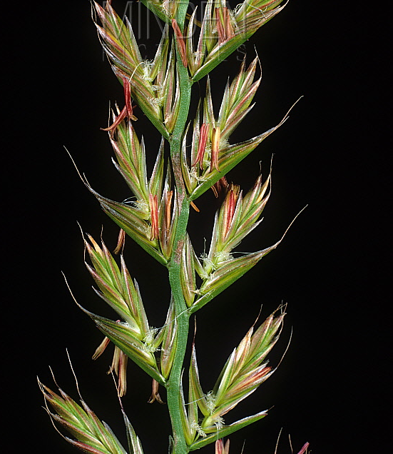
Italian Ryegrass

Slide 20
Italian Ryegrass
Well drained soils with a pH of 6 or greater
Biennial: Suitable for short term leys (2-3 years)
Longer growing season than PRG
More productive than perennial ryegrass
Ideal for intensive silage production
Can have stemmy regrowth

Slide 21
Hybrid Ryegrasses
Cross between species of PRG and IRG
Results in hybrid vigour
  High production levels of IRG
  Less stemmy regrowth than IRG
  Less reseeding needed than IRG

Slide 22
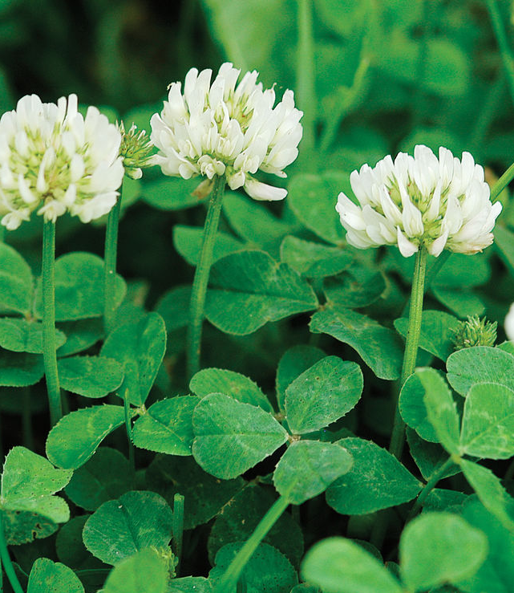
White Clover

Slide 23
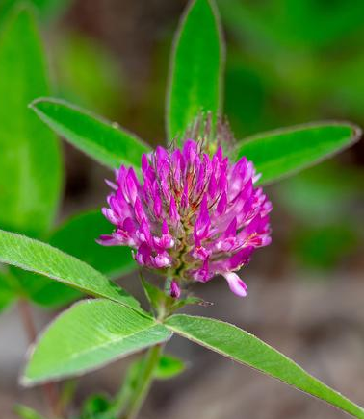
Red Clover

Slide 24
Clover
Member of the Leguminosae family
Often included in seed mixture
  White clover used for grazing
  Red clover used for silage
Have root nodules which contain Rhizobium bacteria that fixes atmospheric Nitrogen into Ammonia
  Reduces the need for artificial fertiliser
Symbiotic relationship between clover and bacteria
  Clover gets nitrogen from the bacteria
  The bacteria get a suitable habitat

Slide 25
Clover
Too much nitrogen can kill off clover in the sward
Too much clover (particularly red) can lead to bloat
  Feed dry hay before turning out onto a legume pasture

Slide 26
Seed Mixtures
A seed mixture is a mixture of either different species or varieties of grass, often with clover.
Both PRG and IRG can be categorised as early, intermediate and late heading varieties based on how far into the growing season the inflorescence emerges.

Slide 27
Seed Mixtures
Grazing: PRG varieties with different heading out dates with white clover.
  Constant supply of fresh grass with high DMD levels.
  Grass does not all go stemmy at the same time.
Silage: IRG varieties with similar heading out dates with red clover.
  Grass growth will be uniform and it will all be ready for cutting at the same time

Slide 28
Food Production
The type of grassland influences the level of food production.
Productivity and Digestibility of a species affects the production levels of a grassland, this in turn affects the stocking rate and the LWG/milk production of food producing animals.

