Slide 1
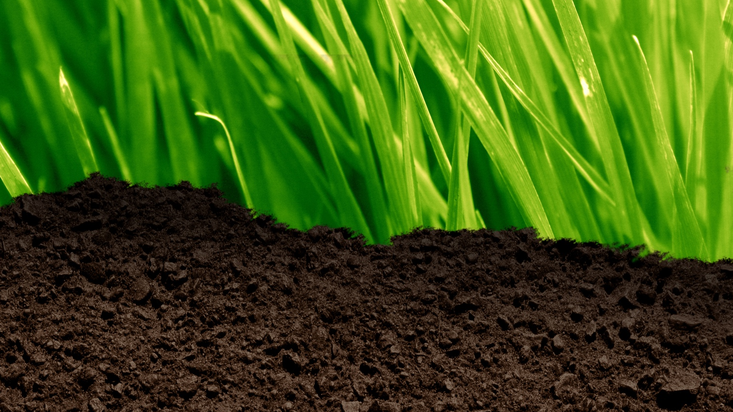

Soil
Biological Properties of Soil

Slide 2
Learning Outcomes
You should be able to:
Explain the term soil microbiome
Appreciate the importance of the rhizosphere and the relationship between soil fungi and roots and the impact of that relationship on productivity
Discuss benefits of earthworms and suitable conditions to improve populations
Discuss the benefits of organic matter
Relate organic matter to soil structure and other properties
Describe the carbon cycle
Describe the nitrogen cycle

Slide 3
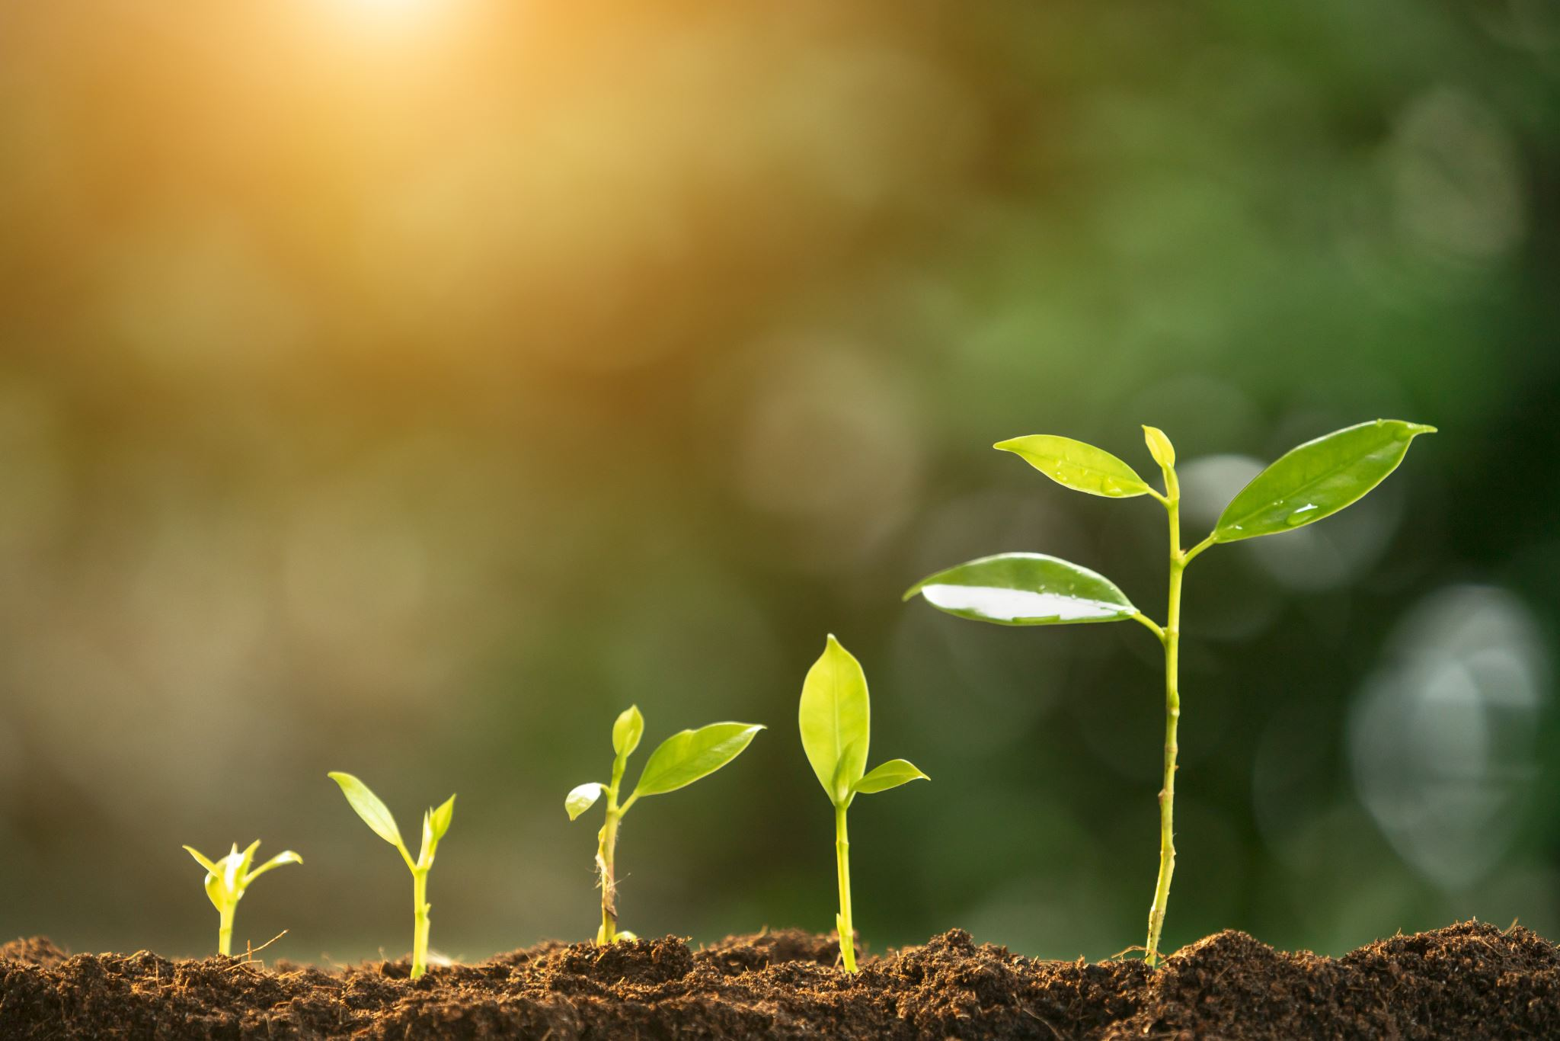
Soil Microbiome
The soil microbiome consists of all living organisms in the soil
Bacteria in the soil are responsible for fixing nutrients into forms that can be absorbed by plants (e.g. nitrogen and phosphorus).
Bacteria in soil also act as decomposers, breaking down organic material into humus. This recycles nutrients so they can be absorbed by plants.
Fungi in soil act as decomposers, breaking down organic material into humus. This recycles nutrients so they can be absorbed by plants. They range from being microscopic to being large.

Slide 4
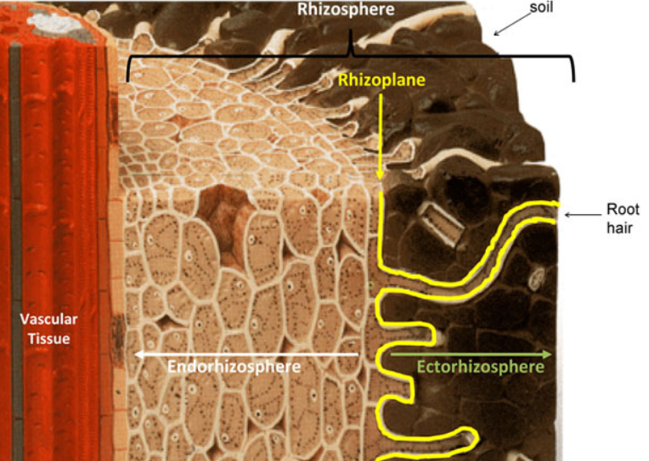
Rhizosphere
The rhizosphere is the area around the roots of a plant occupied by unique microorganisms influenced by the chemicals released from plant roots.
Mycorrhiza fungi are found in symbiotic relationships with the roots of plants. They increase the surface area of the roots for absorption and help dissolve nutrients so they can be absorbed by the roots.
The presence of these fungi increase productivity of crops by improving nutrient uptake.

Slide 5
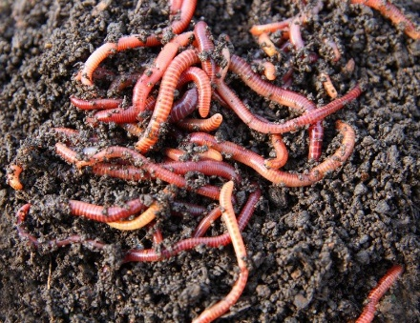
Earthworms
Earthworms are one of the most important macroorganism for the soil.
They do not like acidic or dry soils. Soils should be kept moist and at a close to neutral pH. There should also be adequate drainage.
Earthworms:
  Improve nutrient availability by breaking down organic material to humus which has more nutrients that can be taken up by plants.
  Improve soil structure by creating stable aggregates.
  Burrow, creating channels that improve aeration and drainage.
  Overall productivity is improved.
Minimum cultivation improves earthworm populations as ploughing reduces their population.

Slide 6
Organic Matter
Organic matter is formed when organic material (any material that comes from a living thing e.g. leaves) is broken down by decomposers into a stable state. This decomposed organic matter can also be called humus.
Organic matter:
  provides nutrients to the soil such as nitrogen, phosphorus and sulphur.
  increases the water retaining capabilities of the soil.
  improves soil structure by contributing to aggregate formation.
  helps prevent soil erosion

Slide 7
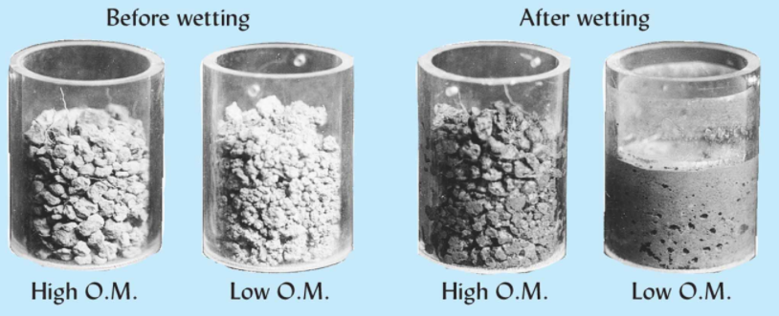
Organic Matter
Minimum cultivation and no-till practices encourage the build up-of organic matter
Cover crops can reduce soil erosion and so help maintain the organic matter in topsoil.
Soils with high organic matter have more stable aggregates.
Aggregates can break down with rainfall if there is low organic matter.

Slide 8
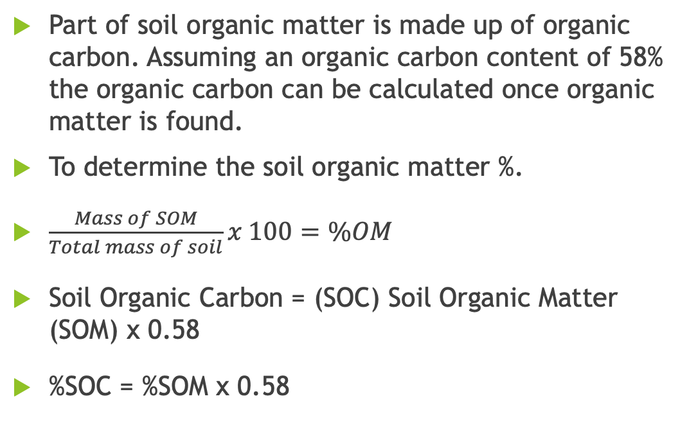
Soil Organic Carbon
Part of soil organic matter is made up of organic carbon. Assuming an organic carbon content of 58% the organic carbon can be calculated once organic matter is found.
To determine the soil organic matter %.
$\frac{Mass of SOM}{Total mass of soil}x 100=\%OM$
Soil Organic Carbon = (SOC) Soil Organic Matter (SOM) x 0.58
%SOC = %SOM x 0.58

Slide 9
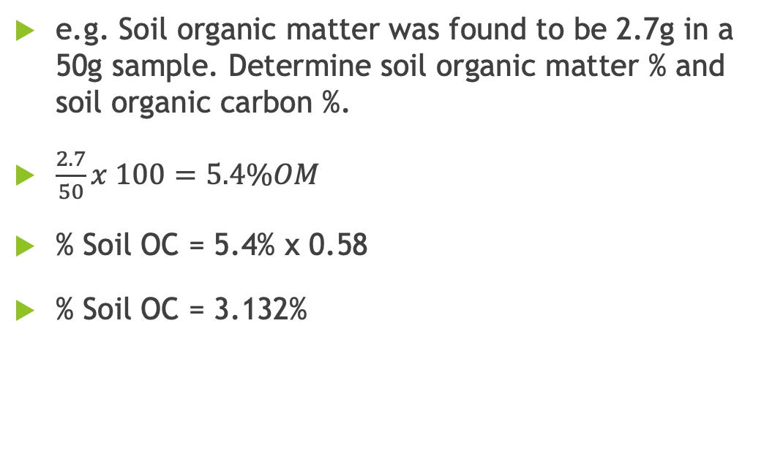
Soil Organic Carbon
e.g. Soil organic matter was found to be 2.7g in a 50g sample. Determine soil organic matter % and soil organic carbon %.
$\frac{2.7}{50}x 100=5.4\%OM$
% Soil OC = 5.4% x 0.58
% Soil OC = 3.132%

Slide 10
Nitrogen Cycle

Slide 11
Nitrogen Cycle
Nitrogen moves through the atmosphere, soil, plants and animals in a cycle.
Nitrogen becomes available to plants when in the form of nitrates.
Nitrogen-fixing bacteria (e.g. Rhizobium from the root nodules of clover) convert atmospheric nitrogen to nitrates.
Nitrates can also be directly added to soil by lightning (converting atmospheric nitrogen to nitrates) and by artificial fertilisers (Such as CAN).

Slide 12
Nitrogen Cycle
This nitrates can be taken up by plants and converted to plant proteins, these are then consumed by animals which convert them to animal proteins.
When animals die or produce waste decomposers produce ammonium from the animal proteins that they are breaking down.
Nitrifying bacteria convert this ammonium to nitrites (Nitrosomonas) and then nitrates (Nitrobacter). This process is called nitrification.
If there is a surplus of nitrates in the soil denitrifying bacteria will convert the nitrates back into nitrogen gas. This process is called denitrification.

Slide 13
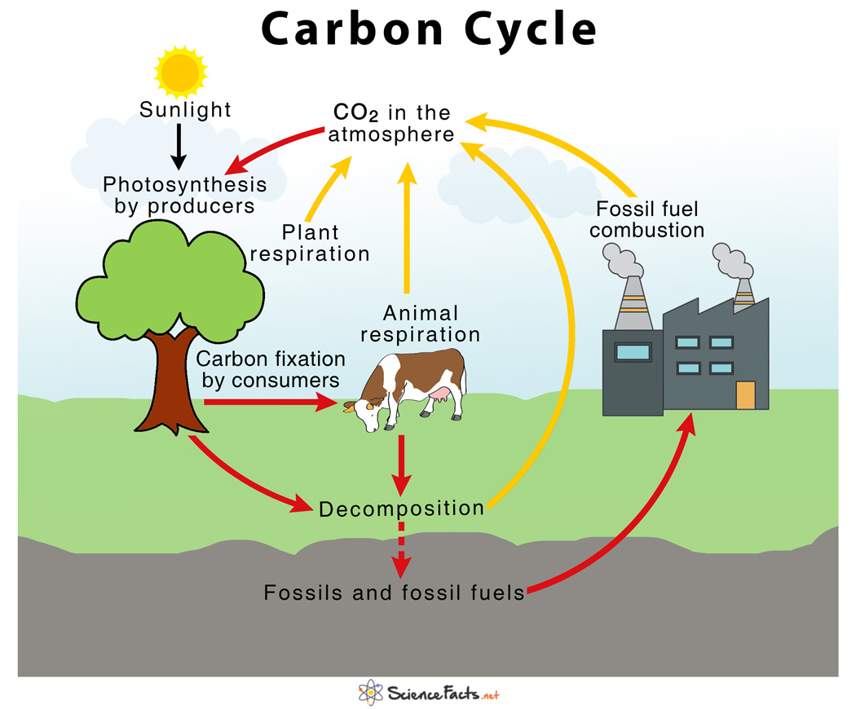
Carbon cycle

Slide 14
Carbon cycle
Carbon moves through the atmosphere, soil, plants and animals in a cycle.
In the air, carbon is mainly found in the form of Carbon dioxide.
Plants remove the Carbon from the air through photosynthesis.
This carbon is consumed by animals when they feed on plants.
Both plants and animals produce carbon dioxide during respiration which returns to the soil.

Slide 15
Carbon cycle
When living things die and decay carbon dioxide is produced by decomposers which returns to the air. The remaining carbon is stored in humus in the soil.
Ruminants also produce methane (CH₄) during digestion which is released into the atmosphere.
Over millions of years dead plants and animals have built up to form fossil fuels underground. This acts as a carbon store.
The combustion of these fossil fuels (and other fuels such as wood) produces carbon dioxide which contributes to the levels in the air

Slide 16
Carbon Sequestration
Carbon sequestration is the long-term capture of carbon dioxide from the atmosphere.
If Carbon levels in soils are decreasing because the output of carbon is higher than the inputs, it is considered a carbon source.
If Carbon levels in soils are increasing because the output of carbon is lower than the inputs, it is considered a carbon sink.
If the input and output levels are balanced the soil carbon is in a steady state.
Maintaining soil carbon can enhance soil quality.
Management strategies that maintain soil carbon levels:
  Reducing deforestation
  Afforestation
  Minimum/No till practices
  Use farmyard manure

